Slide 1

Package Manager and Software Installation in Ubuntu

Slide 2
Package Manager
A collection of software tools that automates the process of installing, upgrading, configuring, and removing computer programs for a computer in a consistent manner.
A package manager deals with packages, distributions of software and data in archive files

Slide 3
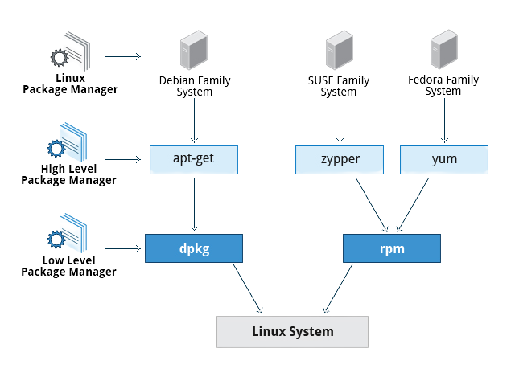
Package Manager

Slide 4




Package Managers
apt: Advanced Package Tool (Ubuntu, Debian)
yum: Yellowdog Updater, Modified (CentOS)
rpm: Red Hat Package Manager (RehHat)
homebrew: package manager for MacOS

Slide 5
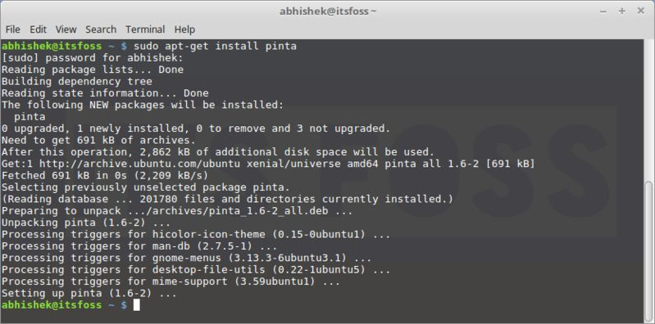
Package Manager
apt: Advanced package tool.

Slide 6
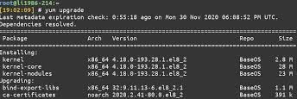
Package Manager
Yum: primary tool for getting, installing, deleting, querying, and otherwise managing Red Hat Enterprise Linux RPM software packages from official Red Hat software repositories.

Slide 7
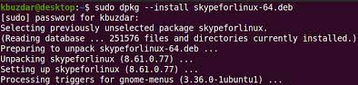
Package Manager
dpkg: Install, remove and manage Debian packages.

Slide 8
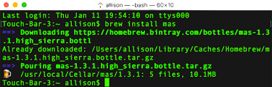
Package Manager
brew: free macOS package manager that allows you to install, update, or remove software by running commands in the terminal.

Slide 9
Advanced Package Tool
apt-get vs apt
apt-get
apt-get is lower-level and "back-end", and supports other APT-based tools.
apt
apt is designed for end-users (humans) and its output may be changed between versions

Slide 10
Repository
collection of deb packages with metadata that is readable by the apt family
In Debian or Ubuntu, the software repositories are defined in /etc/apt/sources.list
Third-party repositories can be added in Ubuntu, add its link to the file mentioned above
Personal Package Archives (PPAs) are software repositories designed for Ubuntu users and are easier to install than other third-party repositories
PPAs are often used to distribute pre-release software so that it can be tested.

Slide 11
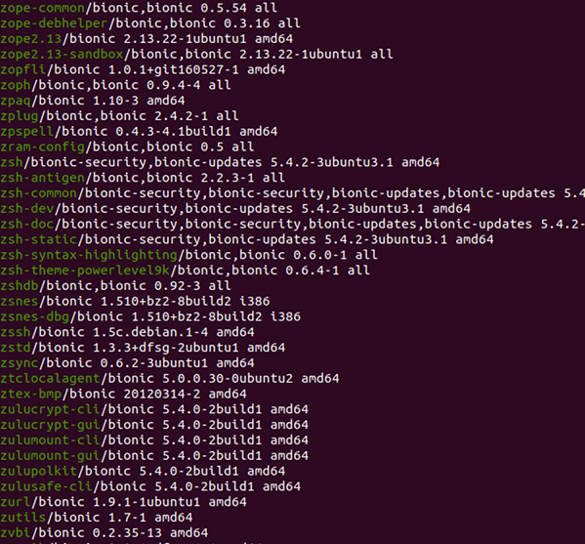
Software Listing
apt list

Slide 12
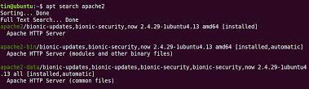
Software Search
apt search [package name. apache2}

Slide 13
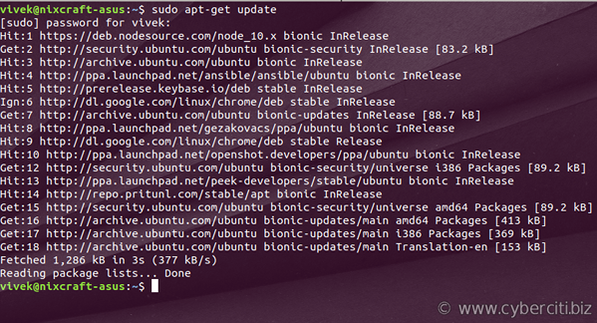
Software Update
apt update.

Slide 14
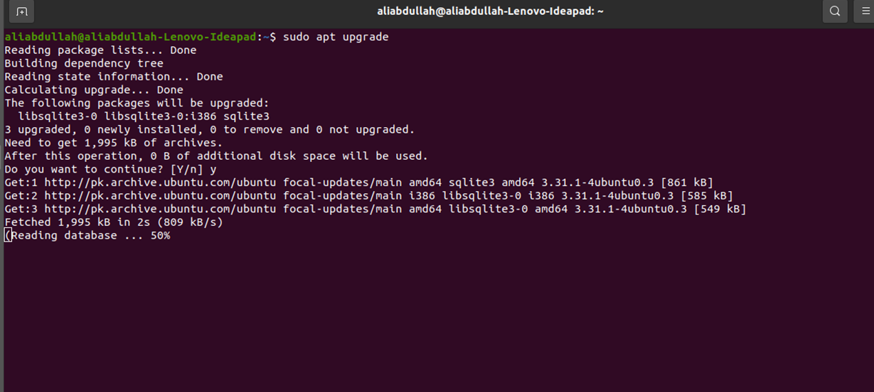
Software Upgrade
apt upgrade.

Slide 15
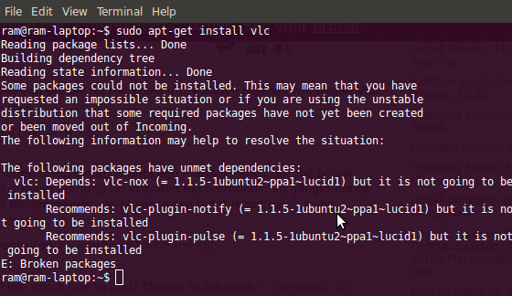
Software Install
apt install {package name. vlc}

Slide 16
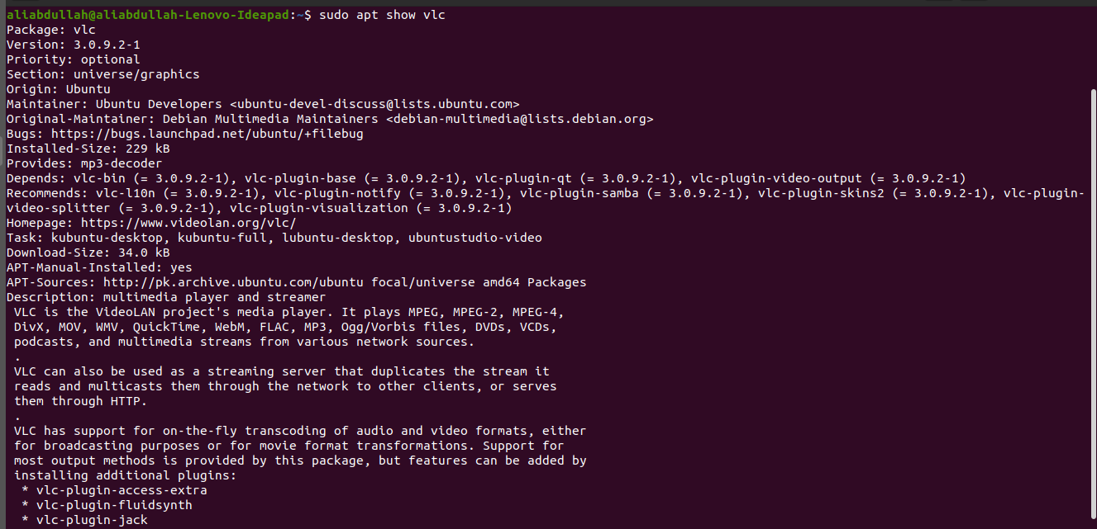
Software Details
apt show {package name. vlc}

Slide 17
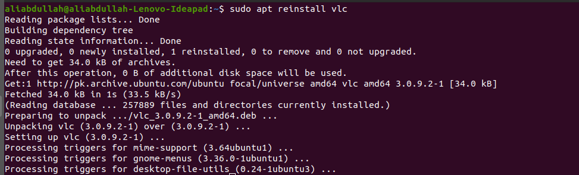
Software Reinstallation
apt reinstall [package-name. skype]

Slide 18
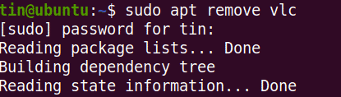
Software Deletion
apt remove [package-name.vlc]

Slide 19
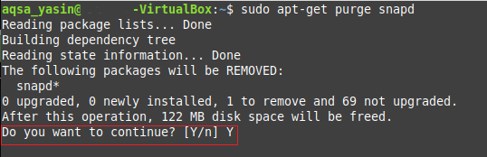
Software Deletion
(With all dependencies removed)
apt purge [package-name.vlc]

Slide 20
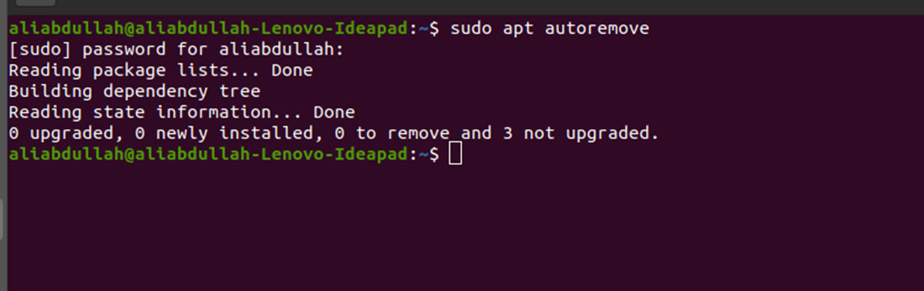
All Unnecessary Softwares Deletion
apt autoremove.

